Slide 1
OpenCV
Sergey Sinitsa
Department of information technology
K-Lab robotics

Slide 2

Install
Debian, Python 2.7:
sudo apt-get install python-opencv
sudo apt-get install libopencv-dev
PIP, Python 3:
pip install opencv-contrib-python

Slide 3
C++ OpenCV Hello World
#include <opencv2/core/core.hpp>
#include <opencv2/highgui/highgui.hpp>
#include <iostream>
using namespace cv;
using namespace std;
int main( int argc, char** argv ) {
if( argc != 2) {
cout <<" Usage: display_image ImageToLoadAndDisplay" << endl;
return -1;
}
Mat image;
image = imread(argv[1], CV_LOAD_IMAGE_COLOR); // Read the file
if(!image.data ) { // Check for invalid input
cout << "Could not open or find the image" << std::endl;
return -1;
}
namedWindow( "Display window", WINDOW_AUTOSIZE );// Create a window.
imshow( "Display window", image ); // Show our image inside it.
waitKey(0); // Wait for a keystroke in the window.
return 0;
}

Slide 4
Python OpenCV Hello World
import cv2
img = cv2.imread('1.jpg')
cv2.namedWindow('Display window', cv2.WINDOW_NORMAL)
cv2.imshow('Display window', img)
cv2.waitKey(0)
cv2.destroyAllWindows()

Slide 5
OpenCV Read from Camera
import cv2
cap = cv2.VideoCapture(0)
# Set camera resolution
cap.set(3, 640)
cap.set(4, 480)
while True:
ret, frame = cap.read()
# Convert to grayscale
gray = cv2.cvtColor(frame, cv2.COLOR_BGR2GRAY)
# Display the resulting frame
cv2.imshow('frame', gray)
if cv2.waitKey(1) & 0xFF == 27:
break
# When everything done, release the capture
cap.release()
cv2.destroyAllWindows()

Slide 6
OpenCV Read from Camera
import cv2
cap = cv2.VideoCapture(0)
# Set camera resolution
cap.set(3, 640)
cap.set(4, 480)
while True:
ret, frame = cap.read()
# Convert to grayscale
gray = cv2.cvtColor(frame, cv2.COLOR_BGR2GRAY)
# Convert to HSV
hsv = cv2.cvtColor(frame, cv2.COLOR_BGR2HSV)
# Display the resulting frame
cv2.imshow('frame', gray)
if cv2.waitKey(1) & 0xFF == 27:
break
# When everything done, release the capture
cap.release()
cv2.destroyAllWindows()

Slide 7
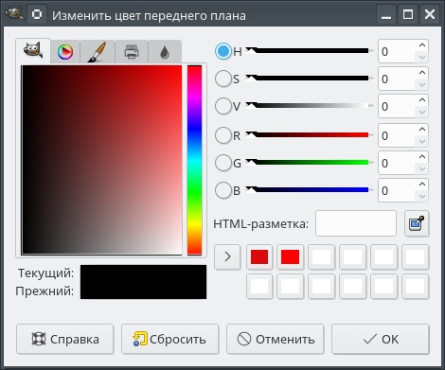
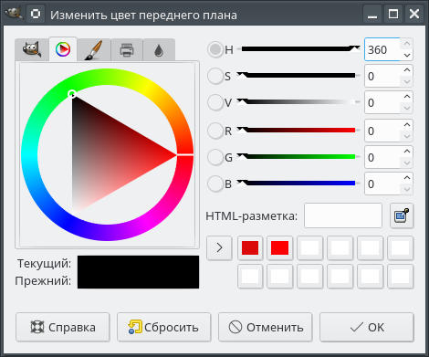
RGB, Grayscale and HSV
RED [0-255] GRAY [0-255] HUE [0-255] OpenCV, [0-360] Gimp
GREEN [0-255] SATURATION [0-255]
BLUE [0-255] VELOCITY or VALUE [0-255]

Slide 8
import cv2
import numpy as np
cap = cv2.VideoCapture(0)
while True:
# Take each frame
_, frame = cap.read()
# Convert BGR to HSV
hsv = cv2.cvtColor(frame, cv2.COLOR_BGR2HSV)
# define range of blue color in HSV
lower_blue = np.array([110,50,50])
upper_blue = np.array([130,255,255])
# Threshold the HSV image to get only blue colors
mask = cv2.inRange(hsv, lower_blue, upper_blue)
# Bitwise-AND mask and original image
res = cv2.bitwise_and(frame,frame, mask= mask)
cv2.imshow('frame',frame)
cv2.imshow('mask',mask)
cv2.imshow('res',res)
k = cv2.waitKey(5) & 0xFF
if k == 27:
break
cv2.destroyAllWindows()

Slide 9
Recording Video from IP Camera
import numpy as np
import cv2
video = cv2.VideoCapture("rtsp://192.168.1.217/stream1")
ok, img = video.read()
gray = cv2.cvtColor(img, cv2.COLOR_BGR2GRAY)
w = int(video.get(cv2.CAP_PROP_FRAME_WIDTH ))
h = int(video.get(cv2.CAP_PROP_FRAME_HEIGHT ))
fourcc = cv2.VideoWriter_fourcc(*'XVID')
video_writer = cv2.VideoWriter("output.mov", fourcc, 25, (w, h))
while (True):
ok, img = video.read()
cv2.imshow('img',img)
prev_gray = gray
gray = cv2.cvtColor(img, cv2.COLOR_BGR2GRAY)
img_diff = cv2.absdiff(gray, prev_gray)
ret, thresh = cv2.threshold(img_diff, 50, 255, cv2.THRESH_BINARY)
cv2.imshow('img_diff', thresh)
video_writer.write(img)
if cv2.waitKey(1) & 0xFF == ord('q'):
break
video.release()
cv2.destroyAllWindows()

Slide 10
Detecting Motion
avg = None
...
while (True):
gray = cv2.cvtColor(frame, cv2.COLOR_BGR2GRAY)
gray = cv2.GaussianBlur(gray, (21, 21), 0)
...
if avg is None:
avg = gray.copy().astype("float")
continue
cv2.accumulateWeighted(gray, avg, 0.5)
frameDelta = cv2.absdiff(gray, cv2.convertScaleAbs(avg))
thresh = cv2.threshold(frameDelta, delta_thresh, 255,
cv2.THRESH_BINARY)[1]
thresh = cv2.dilate(thresh, None, iterations=2)
(_, cnts, _) = cv2.findContours(thresh.copy(), cv2.RETR_EXTERNAL, cv2.CHAIN_APPROX_SIMPLE)
for c in cnts:
if cv2.contourArea(c) < min_area:
continue
(x, y, w1, h1) = cv2.boundingRect(c)
cv2.rectangle(frame, (x, y), (x + w1, y + h1), (0, 255, 0), 2)
motion_detected = True

Slide 11
Direct Access Mat pixels in C++
1-channel:
image.at<uchar>(Point(x,y)) = 255;
3-channel get:
Vec3b colour = image.at<Vec3b>(Point(x, y));
if (colour.val[0]==255 && colour.val[1]==255 && colour.val[2]==255)
3-channel set:
image.at<Vec3b>(Point(x, y))[0] = 255;
image.at<Vec3b>(Point(x, y))[1] = 255;
image.at<Vec3b>(Point(x, y))[2] = 255;

Slide 12
Direct Access pixels in Python
1-channel:
image[x, y]
3-channels:
image[x, y][0]
image[x, y][1]
image[x, y][2]
WARNING: Very SLOW!

Slide 13
Direct Access pixels
Task:
Write a Python program to convert BGR to HSV for each frame and print color values in both color spaces. Access raw BGR pixel values. Draw a crosshair at the center of each frame, detect color value of central pixel and classify it as green, red or blue. Output the as text on the frame.

Slide 14
Tracking objects in real time
1. Search an object by color, get moments of certain colored pixels.
2. Search an object by pattern, KCF algorithm, multiple object tracker
3. Search an object by classifier, Haar Cascades algorithm, convolutional neural networks (CNN)

Slide 15
Tracking objects in real time
1. Search an object by color, get moments of certain colored pixels.
2. Search an object by pattern, KCF algorithm, multiple object tracker
3. Search an object by classifier, Haar Cascades algorithm, convolutional neural networks (CNN)

Slide 16
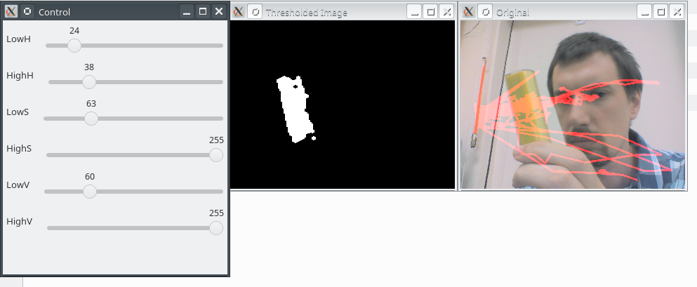
Color tracker in C++

Slide 17
#include <iostream>
#include <time.h>
#include "opencv2/highgui/highgui.hpp"
#include "opencv2/imgproc/imgproc.hpp"
using namespace cv;
using namespace std;
int main( int argc, char** argv ) {
cout << getNumThreads() << endl;
VideoCapture cap(0); //capture the video from webcam
int ret;
ret = cap.set(3, 320);
ret = cap.set(4, 240);
if ( !cap.isOpened() ) // if not success, exit program
{
cout << "Cannot open the web cam" << endl;
return -1;
}
namedWindow("Control", CV_WINDOW_NORMAL); //create a window called "Control"

Slide 18
int iLowH = 170;
int iHighH = 179;
int iLowS = 150;
int iHighS = 255;
int iLowV = 60;
int iHighV = 255;
//Create trackbars in "Control" window
createTrackbar("LowH", "Control", &iLowH, 179); //Hue (0 - 179)
createTrackbar("HighH", "Control", &iHighH, 179);
createTrackbar("LowS", "Control", &iLowS, 255); //Saturation (0 - 255)
createTrackbar("HighS", "Control", &iHighS, 255);
createTrackbar("LowV", "Control", &iLowV, 255);//Value (0 - 255)
createTrackbar("HighV", "Control", &iHighV, 255);

Slide 19
int iLastX = -1;
int iLastY = -1;
// Capture a temporary image from the camera
Mat imgTmp;
cap.read(imgTmp);
// Create a black image with the size as the camera output
Mat imgLines = Mat::zeros( imgTmp.size(), CV_8UC3 );;
time_t start,end;
time (&start);
int frames = 0;
while (true) {
Mat imgOriginal;
bool bSuccess = cap.read(imgOriginal); // read a new frame
//if not success, break loop
if (!bSuccess) {
cout << "Cannot read a frame from video stream" << endl;
break;
}

Slide 20
Mat imgHSV;
cvtColor(imgOriginal, imgHSV, COLOR_BGR2HSV); //Convert the captured frame from BGR to HSV
Mat imgThresholded;
inRange(imgHSV, Scalar(iLowH, iLowS, iLowV), Scalar(iHighH, iHighS, iHighV), imgThresholded); //Threshold the image
//morphological opening (removes small objects from the foreground)
erode(imgThresholded, imgThresholded, getStructuringElement(MORPH_ELLIPSE, Size(5, 5)) );
dilate( imgThresholded, imgThresholded, getStructuringElement(MORPH_ELLIPSE, Size(5, 5)) );
//morphological closing (removes small holes from the foreground)
dilate( imgThresholded, imgThresholded, getStructuringElement(MORPH_ELLIPSE, Size(5, 5)) );
erode(imgThresholded, imgThresholded, getStructuringElement(MORPH_ELLIPSE, Size(5, 5)) );

Slide 21
//Calculate the moments of the thresholded image
Moments oMoments = moments(imgThresholded);
double dM01 = oMoments.m01;
double dM10 = oMoments.m10;
double dArea = oMoments.m00;
// if the area <= 10000, I consider that the there are no object in the image and it's because of the noise, the area is not zero
if (dArea > 10000)
{
//calculate the position of the object
int posX = dM10 / dArea;
int posY = dM01 / dArea;
if (iLastX >= 0 && iLastY >= 0 && posX >= 0 && posY >= 0)
{
//Draw a red line from the previous point to the current point
line(imgLines, Point(posX, posY), Point(iLastX, iLastY), Scalar(0,0,255), 2);
}
iLastX = posX;
iLastY = posY;
}

Slide 22
imshow("Thresholded Image", imgThresholded); //show the thresholded image
imgOriginal = imgOriginal + imgLines;
imshow("Original", imgOriginal); //show the original image
if (waitKey(30) == 27) //wait for 'esc' key press for 30ms. If 'esc' key is pressed, break loop
{
cout << "esc key is pressed by user" << endl;
break;
}
frames++;
}
time (&end);
double dif = difftime (end,start);
printf("FPS %.2lf seconds.\r\n", (frames / dif));
return 0;
}

Slide 23
Color Tracker
Write a Python program to threshold HSV image of each frame to given range to leave certain colored pixels. Calculate the center of the colored object and draw a crosshair on each frame to track the object of given color.

Slide 24
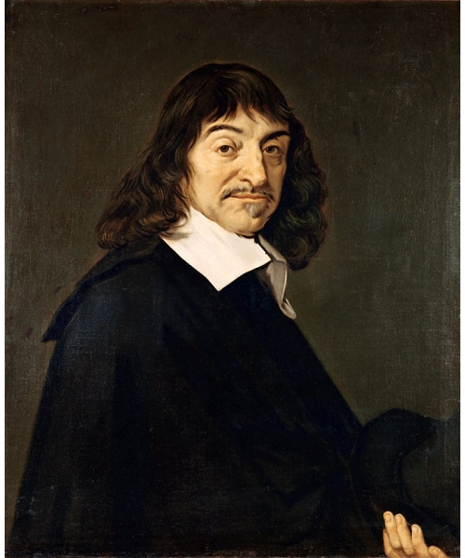
Image Moments
Certain particular weighted average (moment) of the image pixels' intensities, or a function of such moments
May have real world interpretation
May be invariant to translation and/or scale of image
May be Polar or Decart

Slide 25
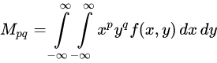
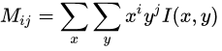
Raw Decart Moments
For a 2D continuous function f(x,y) the moment of order p,q:
for p,q = 0,1,2,... Adapting this to scalar (greyscale) image with pixel intensities I(x,y), raw image moments Mij are calculated by

Slide 26
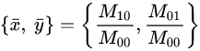
Simple Image Properties via Raw Moments
Area (for binary images) or sum of grey level (for greyscale images):
M₀₀
Centroid:

Slide 27
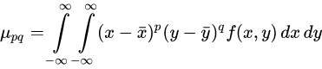
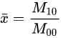
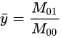
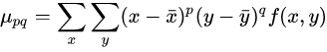
Central Moments
using components of the centroid:
For digital image:

Slide 28
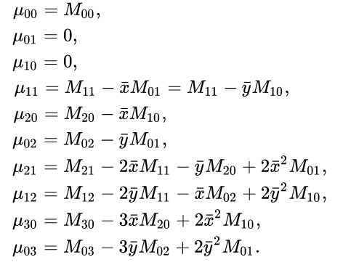
Central Moments for order up to 3
Central moments are translational invariant.
Some combinations are rotation and geometrization invariant [Dudani, 1971].

Slide 29
Central Moments for order up to 3
Central moments are translational invariant.
Some combinations are rotation and geometrization invariant [Dudani, 1971].

Slide 30
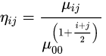
Scale Invariants
Divide central moments to properly scaled zero-th central moment:
where i + j ≥ 2. Translational invariant too.

Slide 31
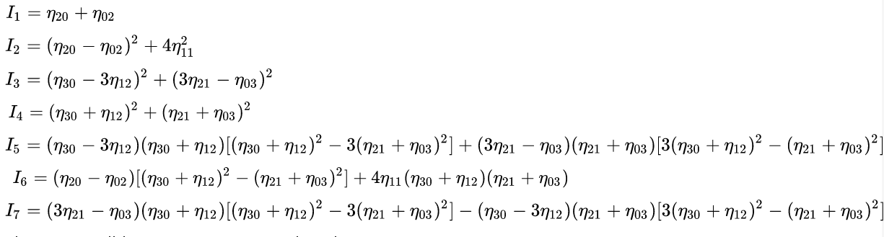
Rotation Invariants
Hu moment invariants are invariant to translation, rotation and scale [1962]
I₁, is analogous to the moment of inertia around the image's centroid, where the pixels' intensities are analogous to physical density.
I₇, is skew invariant, which enables it to distinguish mirror images of otherwise identical images.

Slide 32
Rotation Invariants
J. Flusser fixed Hu moments to be independent and complete.
He removed I₃ and added:

Slide 33
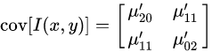
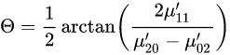
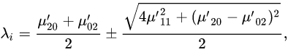
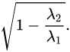
Image Orientation
Construct covariance matrix from 2nd order central moments:
The eigenvectors of this matrix correspond to the major and minor axes of the image intensity, so the orientation can thus be extracted from the angle of the eigenvector associated with the largest eigenvalue towards the axis closest to this eigenvector:
The relative difference in magnitude
of the eigenvalues are thus an indication
of the eccentricity of the image,
or how elongated it is:
The eigenvalues are are proportional
to the squared length of the eigenvector
axes:

Slide 34
Edge Detection
Popular algorithm developed by John F. Canny, 1986:
1. Filter noise with Gaussian Blur.
2. Find the intensity gradients of the image with Sobel edge detector.
3. Apply non-maximum suppression to get rid of spurious response to edge detection.
4. Apply double threshold to determine potential edges.
5. Track edge by hysteresis: suppressing all the other edges that are weak and not connected to strong edges.

Slide 35
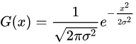
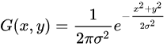
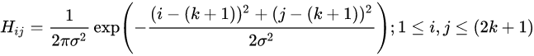
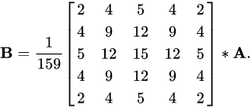
Gaussian Blur
Gaussian filter kernel of size (2k+1)×(2k+1):
Example 5x5 kernel with distribution = 1.4:
* – convolution operation.

Slide 36
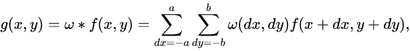
Convolution
where g ( x , y ) is the filtered image,
f ( x , y ) is the original image,
ω is the filter kernel.
Every element of the filter kernel is considered by − a ≤ d x ≤ a and − b ≤ d y ≤ b.

Slide 37
Gaussian Blur
void GaussianBlur(InputArray src, OutputArray dst, Size ksize, double sigmaX, double sigmaY=0, int borderType=BORDER_DEFAULT )
src – input image; the image can have any number of channels, which are processed independently, but the depth should be CV_8U, CV_16U, CV_16S, CV_32F or CV_64F.
dst – output image of the same size and type as src.
ksize – Gaussian kernel size. ksize.width and ksize.height can differ but they both must be positive and odd. Or, they can be zero’s and then they are computed from sigma* .
sigmaX – Gaussian kernel standard deviation in X direction.
sigmaY – Gaussian kernel standard deviation in Y direction; if sigmaY is zero, it is set to be equal to sigmaX, if both sigmas are zeros, they are computed from ksize.width and ksize.height , respectively.
borderType – pixel extrapolation method (see borderInterpolate() for details).

Slide 38
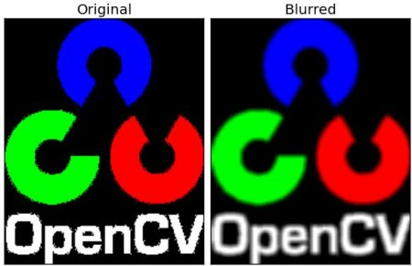
Gaussian Blur

Slide 39
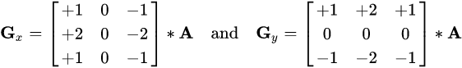
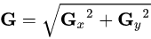
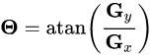
Calculating Gradients
Sobel operator, Sobel–Feldman or Sobel filter
Uses two 3×3 kernels which are convolved with the original image to calculate approximations of the derivatives:
For each point, gradient magnitude: Gradient direction:

Slide 40
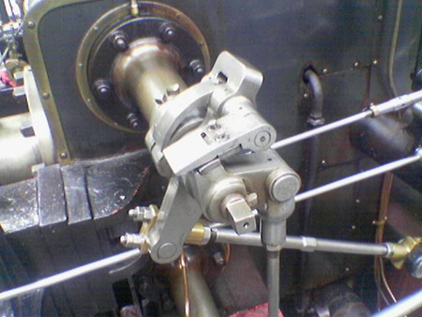
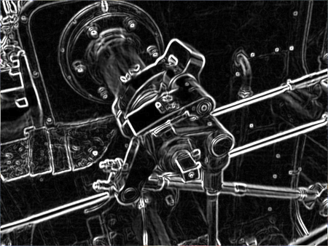
Calculating Gradients
In OpenCV function Sobel()

Slide 41
Calculating Gradients
cv2.Sobel(src, ddepth, dx, dy[, dst[, ksize[, scale[, delta[, borderType]]]]]) → dst¶
src – input image.
dst – output image of the same size and the same number of channels as src .
ddepth –
output image depth; the following combinations of src.depth() and ddepth are supported:
src.depth() = CV_8U, ddepth = -1/CV_16S/CV_32F/CV_64F
src.depth() = CV_16U/CV_16S, ddepth = -1/CV_32F/CV_64F
src.depth() = CV_32F, ddepth = -1/CV_32F/CV_64F
src.depth() = CV_64F, ddepth = -1/CV_64F
when ddepth=-1, the destination image will have the same depth as the source;
in the case of 8-bit input images it will result in truncated derivatives.
xorder – order of the derivative x.
yorder – order of the derivative y.
ksize – size of the extended Sobel kernel; it must be 1, 3, 5, or 7.
scale – optional scale factor for the computed derivative values;
by default, no scaling is applied (see getDerivKernels() for details).
delta – optional delta value that is added to the results prior to storing them in dst.
borderType – pixel extrapolation method (see borderInterpolate() for details).

Slide 42
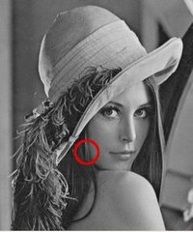
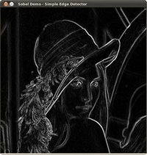
#include "opencv2/imgproc/imgproc.hpp"
#include "opencv2/highgui/highgui.hpp"
#include <stdlib.h>
#include <stdio.h>
using namespace cv;
int main( int argc, char** argv ) {
Mat src, src_gray;
Mat grad;
char* window_name = "Sobel Demo - Simple Edge Detector";
int scale = 1;
int delta = 0;
int ddepth = CV_16S;
int c;
/// Load an image
src = imread( argv[1] );
if( !src.data )
{ return -1; }
GaussianBlur( src, src, Size(3,3), 0, 0, BORDER_DEFAULT );
/// Convert it to gray
cvtColor( src, src_gray, CV_BGR2GRAY );
/// Create window
namedWindow( window_name, CV_WINDOW_AUTOSIZE );
/// Generate grad_x and grad_y
Mat grad_x, grad_y;
Mat abs_grad_x, abs_grad_y;
/// Gradient X
//Scharr( src_gray, grad_x, ddepth, 1, 0, scale, delta, BORDER_DEFAULT );
Sobel( src_gray, grad_x, ddepth, 1, 0, 3, scale, delta, BORDER_DEFAULT );
convertScaleAbs( grad_x, abs_grad_x );
/// Gradient Y
//Scharr( src_gray, grad_y, ddepth, 0, 1, scale, delta, BORDER_DEFAULT );
Sobel( src_gray, grad_y, ddepth, 0, 1, 3, scale, delta, BORDER_DEFAULT );
convertScaleAbs( grad_y, abs_grad_y );
/// Total Gradient (approximate)
addWeighted( abs_grad_x, 0.5, abs_grad_y, 0.5, 0, grad );
imshow( window_name, grad );
waitKey(0);
return 0;
}

Slide 43
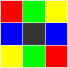
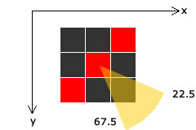
Nonmaximum supression
Separate pixels in 4 bins according to gradient direction:
If the gradient orientation is in this range means change is occurring in this direction - from the top left corner to the bottom right corner. This means the edge lies from the top right corner to bottom left (the red line).
To check if the central red pixel belongs to an edge, you need to check if the gradient is maximum at this point. You do this by comparing its magnitude with the top left pixel and the bottom right pixel.
If it is maximum _and _its magnitude is greater than the upper threshold, you mark this pixel as an edge.
An edge is always perpendicular to the gradient direction. Intensities do not change along an edge - they change across the edge.
http://aishack.in/tutorials/canny-edge-detector/

Slide 44
Thresholding with Hysterysis
After nonmaximum suppression, you'll get something called 'thin edges'.
This might be broken at various points. We'll fix this by filling in gaps with another threshold (with hysteresis).
In the previous step, we marked pixels that had a gradient magnitude greater than the upper threshold.
Now using the direction information and the lower threshold, we'll "grow" these edges.
1) If the current pixel is not an edge, check the next one.
2) If it is an edge, check the two pixels in the direction of the edge (ie, perpendicular to the gradient direction). If either of them (or both)
- Have the direction in the same bin as the central pixel
- Gradient magnitude is greater than the lower threshold
- They are the maximum compared to their neighbors (nonmaximum suppression for these pixels), then you can mark these pixels as an edge pixel
3) Loop until there are no changes in the image.
http://aishack.in/tutorials/canny-edge-detector/

Slide 45
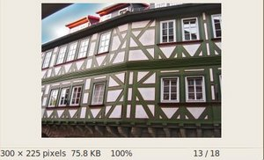
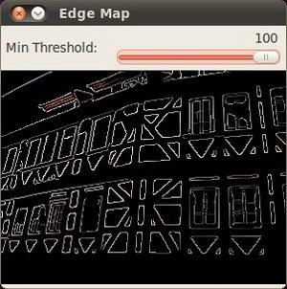
Canny Edge Detection
#include "opencv2/imgproc/imgproc.hpp"
#include "opencv2/highgui/highgui.hpp"
#include <stdlib.h>
#include <stdio.h>
using namespace cv;
/// Global variables
Mat src, src_gray;
Mat dst, detected_edges;
int edgeThresh = 1;
int lowThreshold;
int const max_lowThreshold = 100;
int ratio = 3;
int kernel_size = 3;
char* window_name = "Edge Map";
http://aishack.in/tutorials/canny-edge-detector/

Slide 46
Canny Edge Detection
/**
* Canny thresholds input with a ratio 1:3
*/
void CannyThreshold(int, void*) {
/// Reduce noise with a kernel 3x3
blur( src_gray, detected_edges, Size(3,3) );
/// Canny detector
Canny( detected_edges, detected_edges,
LowThreshold,
lowThreshold*ratio, kernel_size );
/// Using Canny's output as a mask,
we display our result
dst = Scalar::all(0);
src.copyTo( dst, detected_edges);
imshow( window_name, dst );
}
http://aishack.in/tutorials/canny-edge-detector/

Slide 47
Canny Edge Detection
int main( int argc, char** argv ) {
/// Load an image
src = imread( argv[1] );
If ( !src.data ) { return -1; }
/// Create a matrix of the same type and size as src (for dst)
dst.create( src.size(), src.type() );
/// Convert the image to grayscale
cvtColor( src, src_gray, CV_BGR2GRAY );
/// Create a window
namedWindow( window_name, CV_WINDOW_AUTOSIZE );
/// Create a Trackbar for user to enter threshold
createTrackbar( "Min Threshold:", window_name,
&lowThreshold, max_lowThreshold, CannyThreshold );
/// Show the image
CannyThreshold(0, 0);
/// Wait until user exit program by pressing a key
waitKey(0);
return 0;
}
http://aishack.in/tutorials/canny-edge-detector/

Slide 48
Morphological Operations
A set of operations that process images based on shapes. Morphological operations apply a structuring element to an input image and generate an output image.
The most basic morphological operations are two: Erosion and Dilation. They have a wide array of uses:
- Removing noise
- Isolation of individual elements and joining disparate elements in an image.
- Finding of intensity bumps or holes in an image
Learning OpenCV by Bradski and Kaehler.

Slide 49
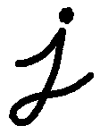
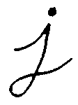
Dilation
The background (bright) dilates around the black regions of the letter.
Learning OpenCV by Bradski and Kaehler.

Slide 50

Dilation
Inverted example. The dilatation makes the object in white bigger.
Learning OpenCV by Bradski and Kaehler.

Slide 51
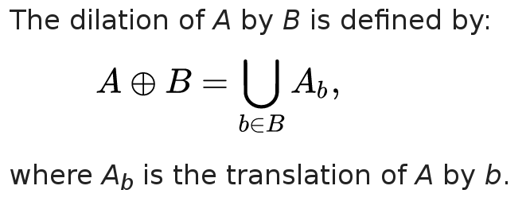
Dilation
In binary morphology, dilation is a shift-invariant (translation invariant) operator, equivalent to Minkowski addition.
A binary image is viewed in mathematical
morphology as a subset of a Euclidean
space R_d or the integer grid Z_d,
for some dimension d.
Let E be a Euclidean space or an integer grid,
A a binary image in E,
and B a structuring element
regarded as a subset of R_d.

Slide 52
Binary Dilation Properties
It is translation invariant.
It is increasing, that is, if A ⊆ C then A ⊕ B ⊆ C ⊕ B
It is commutative.
If the origin of E belongs to the structuring element B, then it is extensive, i.e., A ⊆ A ⊕ B.
It is associative, i.e., ( A ⊕ B ) ⊕ C = A ⊕ ( B ⊕ C )
It is distributive over set union (A⊕B + A⊕C = A⊕(B+C))

Slide 53
Binary Dilation Example
0 0 0 0 0 0 0 0 0 0 0
0 1 1 1 1 0 0 1 1 1 0
0 1 1 1 1 0 0 1 1 1 0
0 1 1 1 1 1 1 1 1 1 0
0 1 1 1 1 1 1 1 1 1 0 1 1 1
0 1 1 0 0 0 1 1 1 1 0 ⊕ 1 1 1 =
0 1 1 0 0 0 1 1 1 1 0 1 1 1
0 1 1 0 0 0 1 1 1 1 0
0 1 1 1 1 1 1 1 0 0 0
0 1 1 1 1 1 1 1 0 0 0
0 0 0 0 0 0 0 0 0 0 0
1 1 1 1 1 1 1 1 1 1 1
1 1 1 1 1 1 1 1 1 1 1
1 1 1 1 1 1 1 1 1 1 1
1 1 1 1 1 1 1 1 1 1 1
1 1 1 1 1 1 1 1 1 1 1
1 1 1 1 1 1 1 1 1 1 1
1 1 1 1 0 1 1 1 1 1 1
1 1 1 1 1 1 1 1 1 1 1
1 1 1 1 1 1 1 1 1 1 1
1 1 1 1 1 1 1 1 1 0 0
1 1 1 1 1 1 1 1 1 0 0

Slide 54
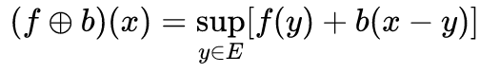
Grayscale Dilation
In grayscale morphology, images are functions mapping a Euclidean space or grid E into R ∪ { ∞ , − ∞ } , where R is the set of reals, ∞ is an element greater than any real number, and − ∞ is an element less than any real number.
Grayscale structuring elements are also functions of the same format, called "structuring functions".
Denoting an image by f(x) and the structuring function by b(x), sup is a supremum, the grayscale dilation of f by b is given by

Slide 55
Multichanel Dilation
Same as grayscale for each chanel.
Each channel is processed independently.

Slide 56
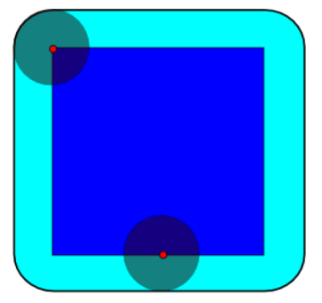
Dilation With non Square Kernel
The dilation of dark-blue square by a disk,
resulting in the light-blue square with rounded corners.

Slide 57
Dilation
This operations consists of convoluting an image A with some kernel or structuring element (B), which can have any shape or size, usually a square or circle.
The kernel B has a defined anchor point, usually being the center of the kernel.
As the kernel B is scanned over the image, we compute the maximal pixel value overlapped by B and replace the image pixel in the anchor point position with that maximal value. This maximizing operation causes bright regions within an image to “grow” (therefore the name dilation - расширение).
Learning OpenCV by Bradski and Kaehler.

Slide 58
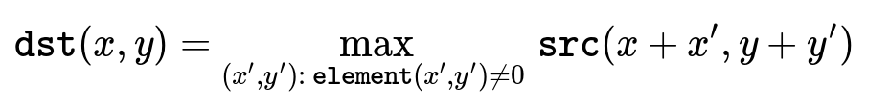
Dilation
https://docs.opencv.org/3.4.1/d4/d86/group__imgproc__filter.html

Slide 59
Dilation in OpenCV
void cv::dilate (
InputArray src,
OutputArray dst,
InputArray kernel,
Point anchor = Point(-1,-1),
int iterations = 1,
int borderType = BORDER_CONSTANT,
const Scalar &borderValue =
morphologyDefaultBorderValue()
)
Python:
Dst = cv.dilate( src, kernel[, dst[, anchor[, iterations[, borderType[, borderValue]]]]] )
https://docs.opencv.org/3.4.1/d4/d86/group__imgproc__filter.html

Slide 60
Dilation in OpenCV
src input image; the number of channels can be arbitrary, but the depth should be one of CV_8U, CV_16U, CV_16S, CV_32F or CV_64F.
dst output image of the same size and type as src.
kernel structuring element used for dilation; if elemenat=Mat(), a 3 x 3 rectangular structuring element is used. Kernel can be created using getStructuringElement
anchor position of the anchor within the element; default value (-1, -1) means that the anchor is at the element center.
iterations number of times dilation is applied.
borderType pixel extrapolation method, see BorderTypes
borderValue border value in case of a constant border
https://docs.opencv.org/3.4.1/d4/d86/group__imgproc__filter.html

Slide 61
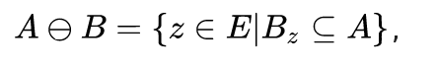
Binary Erosion
Let E be a Euclidean space or an integer grid, and A a binary image in E.
The erosion of the binary image A by the structuring element B is defined by:
Where Bz is the translation of B by the vector z, i.e., B z = { b + z | b ∈ B } , ∀ z.

Slide 62
Binary Erosion
1 1 1 1 1 1 1 1 1 1 1 1 1
1 1 1 1 1 1 0 1 1 1 1 1 1
1 1 1 1 1 1 1 1 1 1 1 1 1
1 1 1 1 1 1 1 1 1 1 1 1 1
1 1 1 1 1 1 1 1 1 1 1 1 1
1 1 1 1 1 1 1 1 1 1 1 1 1 1 1 1
1 1 1 1 1 1 1 1 1 1 1 1 1 ⊖ 1 1 1 =
1 1 1 1 1 1 1 1 1 1 1 1 1 1 1 1
1 1 1 1 1 1 1 1 1 1 1 1 1
1 1 1 1 1 1 1 1 1 1 1 1 1
1 1 1 1 1 1 1 1 1 1 1 1 1
1 1 1 1 1 1 1 1 1 1 1 1 1
1 1 1 1 1 1 1 1 1 1 1 1 1
0 0 0 0 0 0 0 0 0 0 0 0 0
0 1 1 1 1 0 0 0 1 1 1 1 0
0 1 1 1 1 0 0 0 1 1 1 1 0
0 1 1 1 1 1 1 1 1 1 1 1 0
0 1 1 1 1 1 1 1 1 1 1 1 0
0 1 1 1 1 1 1 1 1 1 1 1 0
0 1 1 1 1 1 1 1 1 1 1 1 0
0 1 1 1 1 1 1 1 1 1 1 1 0
0 1 1 1 1 1 1 1 1 1 1 1 0
0 1 1 1 1 1 1 1 1 1 1 1 0
0 1 1 1 1 1 1 1 1 1 1 1 0
0 1 1 1 1 1 1 1 1 1 1 1 0
0 0 0 0 0 0 0 0 0 0 0 0 0

Slide 63
Binary Erosion Properties
The erosion is translation invariant.
It is increasing, that is, if A ⊆ C, then A ⊖ B ⊆ C ⊖ B.
If the origin of E belongs to the structuring element B, then the erosion is anti-extensive, i.e., A ⊖ B ⊆ A.
The erosion satisfies ( A ⊖ B ) ⊕ C = A ⊖ ( B ⊕ C ), where ⊕ denotes the morphological dilation.
The erosion is distributive over set intersection.

Slide 64
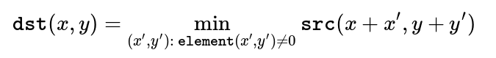
Erosion
This operation is the sister of dilation. It computes a local minimum over the area of given kernel.
As the kernel B is scanned over the image, we compute the minimal pixel value overlapped by B and replace the image pixel under the anchor point with that minimal value.

Slide 65


Erosion
The bright areas of the image get thinner (erodes -- разрушается),
whereas the dark zones gets bigger.

Slide 66
Erosion in OpenCV
void cv::erode ( InputArray src,
OutputArray dst,
InputArray kernel,
Point anchor = Point(-1,-1),
int iterations = 1,
int borderType = BORDER_CONSTANT,
const Scalar & borderValue = morphologyDefaultBorderValue()
)
Python:
Dst = cv.erode( src, kernel[, dst[, anchor[, iterations[, borderType[, borderValue]]]]] )
https://docs.opencv.org/3.4.1/d4/d86/group__imgproc__filter.html

Slide 67
Morphological opening
// Removes small objects from the foreground
erode(imgThresholded, imgThresholded,
getStructuringElement(MORPH_ELLIPSE, Size(5, 5)) );
dilate( imgThresholded, imgThresholded,
getStructuringElement(MORPH_ELLIPSE, Size(5, 5)) );
https://docs.opencv.org/3.4.1/d4/d86/group__imgproc__filter.html

Slide 68
Searching for object contours
COMPUTER VISION, GRAPHICS, AND IMAGE PROCESSING N,32-46
(1985)
Topological Structural Analysis of Digitized Binary Images by Border Following
SATOSHI SUZUKI
Graduate School of Electronic Science and Technology, Shizuoka University,
Hamamatsu 432, Japan
KEIICHI ABE
Department of Computer Science, Shizuoka University, Hamamatsu 432, Japan
Received December 16,1983
https://docs.opencv.org/3.4.1/d4/d86/group__imgproc__filter.html

Slide 69
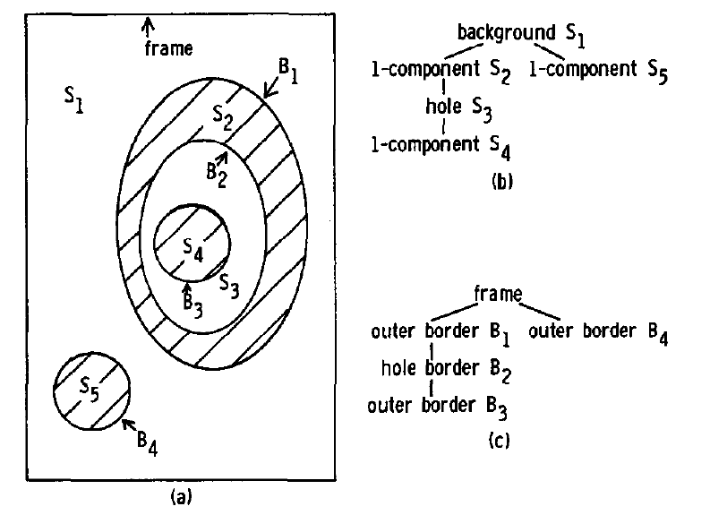
Searching for object contours
Border following finds border betwen 1-pixel components and 0-pixel components.
Topological structure a representation of image as a hierarchy of borders or contours.
Topological Structural Analysis of Digitized Binary Images by Border Following SATOSHI et. al.

Slide 70
Topological structure algorithm
Scan an input binary picture with a TV raster and interrupt the raster scan when a pixel (i, j) is found which satisfies the condition for the border following starting point of either an outer border (Fig. 2a) or a hole border (Fig. 2b). If the pixel (i, j) satisfies both of the above conditions, (i, j) must be regarded as the starting point of the outer border. Assign a uniquely identifiable number to the newly found border. Let us call it the sequential number of the border and denote it by NBD.
Determine the parent border of the newly found border as follows. During the raster scan we also keep the sequential number LNBD of the (outer or hole) border encountered most recently. This memorized border should be either the parent border of the newly found border or a border which shares the common parent with the newly found border. Therefore, we can decide the sequential number of the parent border of the newly found border with the types of the two borders according to Table 1.
Follow the found border from the starting point, marking the pixels on the border. The border following schemeis the classical one*; the distinguished feature of our algorithm is the marking policy.
(a) If the current following border is between the 0-component which contains the pixel (p, q + 1) and the l-component which contains the pixel (p, q), change the value of the pixel (p, q) to — NBD.
(b) Otherwise, set the value of the pixel (p, q) to NBD unless (p, q) is on an already followed border.
The conditions (a) and (b) prohibit the pixel (p, q) from being the border following starting points of the already followed hole border and outer border, respectively. The positive value NBD and the negative value, -NBD, correspond to the labels “1” and “ r” of the border following algorithm in [l], respectively. After following and marking the entire border, resume the raster scan. When the
scan reaches the lower right comer of the picture, the algorithm stops.
Topological Structural Analysis of Digitized Binary Images by Border Following SATOSHI et. al.

Slide 71
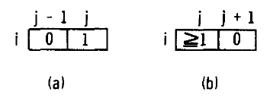
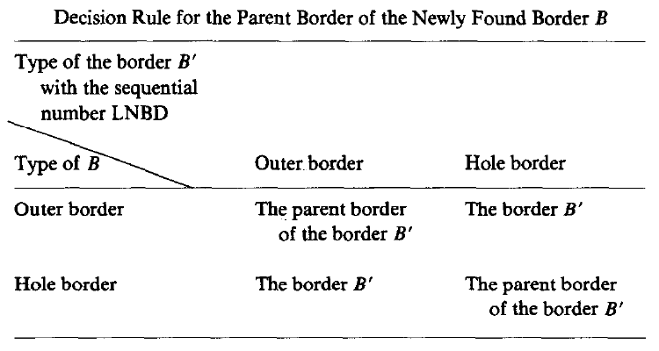
Topological structure algorithm
Topological Structural Analysis of Digitized Binary Images by Border Following SATOSHI et. al.

Slide 72
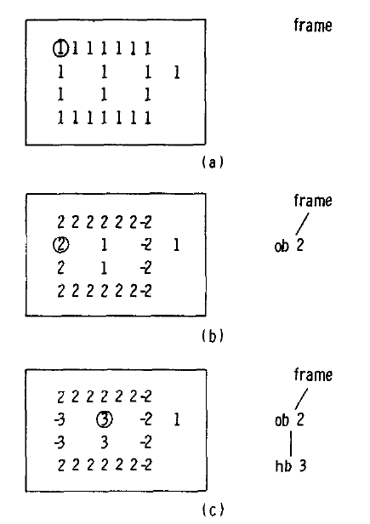
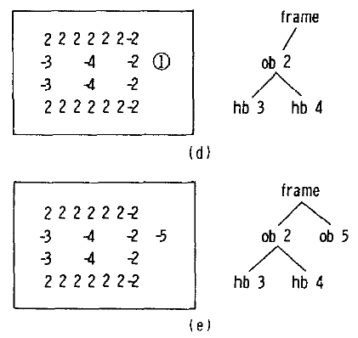
Topological structure algorithm
The left-hand figures show the pixel values and the right-hand the extracted structures among borders (ob: outer border, hb: hole border). The circled pixels are the starting points of border following.
Topological Structural Analysis of Digitized Binary Images by Border Following SATOSHI et. al.

Slide 73
Find contours in OpenCV
void cv::findContours ( InputOutputArray image,
OutputArrayOfArrays contours,
OutputArray hierarchy,
int mode,
int method,
Point offset = Point()
)
Finds contours in a binary image.
https://docs.opencv.org/3.4.1/d4/d86/group__imgproc__filter.html

Slide 74
Find contours in OpenCV
image Source, an 8-bit single-channel image. Non-zero pixels are treated as 1's. Zero pixels remain 0's, so the image is treated as binary . You can use cv::compare, cv::inRange, cv::threshold , cv::adaptiveThreshold, cv::Canny, and others to create a binary image out of a grayscale or color one. If mode equals to cv::RETR_CCOMP or cv::RETR_FLOODFILL, the input can also be a 32-bit integer image of labels (CV_32SC1).
contours Detected contours. Each contour is stored as a vector of points (e.g. std::vector<std::vector<cv::Point> >).
hierarchy Optional output vector (e.g. std::vector<cv::Vec4i>), containing information about the image topology. It has as many elements as the number of contours. For each i-th contour contours[i], the elements hierarchy[i][0] , hierarchy[i][1] , hierarchy[i][2] , and hierarchy[i][3] are set to 0-based indices in contours of the next and previous contours at the same hierarchical level, the first child contour and the parent contour, respectively. If for the contour i there are no next, previous, parent, or nested contours, the corresponding elements of hierarchy[i] will be negative.
mode Contour retrieval mode, see cv::RetrievalModes
method Contour approximation method, see cv::ContourApproximationModes
offset Optional offset by which every contour point is shifted. This is useful if the contours are extracted from the image ROI and then they should be analyzed in the whole image context.
https://docs.opencv.org/3.4.1/d4/d86/group__imgproc__filter.html

Slide 75
Find contours in OpenCV: mode
RETR_EXTERNAL
retrieves only the extreme outer contours. It sets hierarchy[i][2]=hierarchy[i][3]=-1 for all the contours.
RETR_LIST
retrieves all of the contours without establishing any hierarchical relationships.
RETR_CCOMP
retrieves all of the contours and organizes them into a two-level hierarchy. At the top level, there are external boundaries of the components. At the second level, there are boundaries of the holes. If there is another contour inside a hole of a connected component, it is still put at the top level.
RETR_TREE
retrieves all of the contours and reconstructs a full hierarchy of nested contours.
RETR_FLOODFILL
https://docs.opencv.org/3.4.1/d4/d86/group__imgproc__filter.html

Slide 76
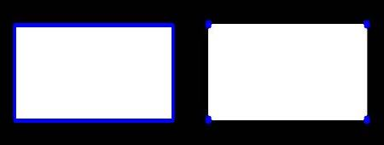
Find contours in OpenCV: method
CHAIN_APPROX_NONE
stores absolutely all the contour points. That is, any 2 subsequent points (x1,y1) and (x2,y2) of the contour will be either horizontal, vertical or diagonal neighbors, that is, max(abs(x1-x2),abs(y2-y1))==1.
CHAIN_APPROX_SIMPLE
compresses horizontal, vertical, and diagonal segments and leaves only their end points. For example, an up-right rectangular contour is encoded with 4 points.
CHAIN_APPROX_TC89_L1
applies one of the flavors of the Teh-Chin chain approximation algorithm *
CHAIN_APPROX_TC89_KCOS
applies one of the flavors of the Teh-Chin chain approximation algorithm *
* C-H Teh and Roland T. Chin. On the detection of dominant points on digital curves. Pattern Analysis and Machine Intelligence, IEEE Transactions on, 11(8):859–872, 1989.
CHAIN_APPROX_NONE = 734 points
CHAIN_APPROX_SIMPLE = 4 points
https://docs.opencv.org/3.3.1/d4/d73/tutorial_py_contours_begin.html
https://docs.opencv.org/3.3.1/d3/dc0/group__imgproc__shape.html#ga4303f45752694956374734a03c54d5ff

Slide 77
Find contours in OpenCV
Mat canny_output;
vector<vector<Point> > contours;
vector<Vec4i> hierarchy;
/// Detect edges using canny
Canny( src_gray, canny_output, thresh, thresh*2, 3 );
/// Find contours
findContours( canny_output, contours, hierarchy, CV_RETR_TREE, CV_CHAIN_APPROX_SIMPLE, Point(0, 0) );
/// Draw contours
Mat drawing = Mat::zeros( canny_output.size(), CV_8UC3 );
for( int i = 0; i< contours.size(); i++ )
{
Scalar color = Scalar( rng.uniform(0, 255), rng.uniform(0,255), rng.uniform(0,255) );
drawContours( drawing, contours, i, color, 2, 8, hierarchy, 0, Point() );
}
/// Show in a window
namedWindow( "Contours", CV_WINDOW_AUTOSIZE );
imshow( "Contours", drawing );
https://docs.opencv.org/2.4/doc/tutorials/imgproc/shapedescriptors/find_contours/find_contours.html

Slide 78
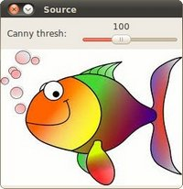

Find contours in OpenCV
https://docs.opencv.org/2.4/doc/tutorials/imgproc/shapedescriptors/find_contours/find_contours.html

Slide 79
Pattern Tracker
Search an object by pattern, KCF algorithm
OpenCV 3 recommended:
sudo apt-get install python-pip
pip install opencv-contrib-python

Slide 80
#! /usr/bin/env python
# -*- coding: utf-8 -*-
import cv2
import sys
import string
if __name__ == '__main__' :
version = string.split(cv2.__version__, '.')
major_ver = version[0];
minor_ver = version[1];
subminor_ver = version[2];

Slide 81
# Set up tracker.
# Instead of MIL, you can also use
tracker_types = ['BOOSTING', 'MIL','KCF', 'TLD', 'MEDIANFLOW', 'GOTURN']
tracker_type = tracker_types[2]
if int(minor_ver) < 3:
tracker = cv2.Tracker_create(tracker_type)
else:
if tracker_type == 'BOOSTING':
tracker = cv2.TrackerBoosting_create()
if tracker_type == 'MIL':
tracker = cv2.TrackerMIL_create()
if tracker_type == 'KCF':
tracker = cv2.TrackerKCF_create()
if tracker_type == 'TLD':
tracker = cv2.TrackerTLD_create()
if tracker_type == 'MEDIANFLOW':
tracker = cv2.TrackerMedianFlow_create()
if tracker_type == 'GOTURN':
tracker = cv2.TrackerGOTURN_create()

Slide 82
# Read video
video = cv2.VideoCapture(0)
# Exit if video not opened.
if not video.isOpened():
print "Could not open video"
sys.exit()
# Read first frame.
ok, frame = video.read()
if not ok:
print 'Cannot read video file'
sys.exit()

Slide 83

# Define an initial bounding box
bbox = (287, 23, 86, 320)
# Select a different bounding box with mouse, press ESC to continue
bbox = cv2.selectROI(frame, False)
# Initialize tracker with first frame and bounding box
ok = tracker.init(frame, bbox)

Slide 84
while True:
# Read a new frame
ok, frame = video.read()
if not ok:
break
# Start timer
timer = cv2.getTickCount()
# Update tracker
ok, bbox = tracker.update(frame)
# Calculate Frames per second (FPS)
fps = cv2.getTickFrequency() / (cv2.getTickCount() - timer);

Slide 85
# Draw bounding box
if ok:
# Tracking success
p1 = (int(bbox[0]), int(bbox[1]))
p2 = (int(bbox[0] + bbox[2]), int(bbox[1] + bbox[3]))
cv2.rectangle(frame, p1, p2, (255,0,0), 2, 1)
else :
# Tracking failure
cv2.putText(frame, "Tracking failure detected", (100,80), cv2.FONT_HERSHEY_SIMPLEX, 0.75,(0,0,255),2)
# Display tracker type on frame
cv2.putText(frame, tracker_type + " Tracker", (100,20), cv2.FONT_HERSHEY_SIMPLEX, 0.75, (50,170,50),2);
# Display FPS on frame
cv2.putText(frame, "FPS : " + str(int(fps)), (100,50), cv2.FONT_HERSHEY_SIMPLEX, 0.75, (50,170,50), 2);
# Display result
cv2.imshow("Tracking", frame)
# Exit if ESC pressed
k = cv2.waitKey(1) & 0xff
if k == 27 : break

Slide 86
Pattern Tracker, KCF algorithm
Initial image patch is given.
The goal is to learn a classifier to discriminate between patch appeirance and an environment in video stream.
New detections provide new image patches to update the model.
TBD - Tracking by detection.
TLD — Track-Learn-Detect.
Classifier is trained on positive samples.
Discriminative methods respect negative samples of the environment from different image parts with different scales.
Unlimited negative samples. Random number of samples used.
Many image parts need to be compared fast.
High-Speed Tracking with Kernelized Correlation Filters João F. Henriques, Rui Caseiro, Pedro Martins, and Jorge Batista

Slide 87


Linear regression, Tikhonov regularization (ridge regression)
The goal of training to find a function f(z) = w^{T}z that minimizes the squared error over samples x_{i} and their regression targets y_{i}
The λ is a regularization parameter that controls overfitting.
The minimizer has a closed-form:
The data matrix X has one sample per row x_{i},
each element of y is a regression target y_{i}.
I is an identity matrix.
High-Speed Tracking with Kernelized Correlation Filters João F. Henriques, Rui Caseiro, Pedro Martins, and Jorge Batista

Slide 88

Kernelized corellation filter
Correlation filters use the fact that convolution of two patches (their dot-product at different relative translations) is equivalent to an element-wise product in their Fourier domain. By formulating desired results in Fourier domain they can formulating their objective in the specify the desired output of a Fourier domain, they can specify the desired output of a linear classifier for several translations,
or image shifts, at once.
High-Speed Tracking with Kernelized Correlation Filters João F. Henriques, Rui Caseiro, Pedro Martins, and Jorge Batista

Slide 89



Cyclic shifts simplify linear regression
High-Speed Tracking with Kernelized Correlation Filters João F. Henriques, Rui Caseiro, Pedro Martins, and Jorge Batista

Slide 90



Discrete Fourier Transform
The Fourier Transform will decompose an image into its sinus and cosines components.
f is the image value in its spatial domain and F in its frequency domain. The result of the transformation is complex numbers. Displaying this is possible either via a real image and a complex image or via a magnitude and a phase image. However, throughout the image processing algorithms only the magnitude image is interesting as this contains all the information we need about the images geometric structure.
Эрмитово-сопряженная матрица, комплексное сопряжение (a - ib)
High-Speed Tracking with Kernelized Correlation Filters João F. Henriques, Rui Caseiro, Pedro Martins, and Jorge Batista

Slide 91




Discrete Fourier Transform
You can see that the most influential components of the frequency domain (brightest dots on the magnitude image) follow the geometric rotation of objects on the image. From this we may calculate the offset and perform an image rotation to correct eventual miss alignments. https://docs.opencv.org/3.4/d8/d01/tutorial_discrete_fourier_transform.html

Slide 92


Nonlinear Regression – kernel trick
High-Speed Tracking with Kernelized Correlation Filters João F. Henriques, Rui Caseiro, Pedro Martins, and Jorge Batista

Slide 93



Nonlinear Regression – kernel trick
High-Speed Tracking with Kernelized Correlation Filters João F. Henriques, Rui Caseiro, Pedro Martins, and Jorge Batista

Slide 94


Nonlinear Regression – kernel trick
^ = DFT of a vector
High-Speed Tracking with Kernelized Correlation Filters João F. Henriques, Rui Caseiro, Pedro Martins, and Jorge Batista

Slide 95

Nonlinear Regression – kernel trick
High-Speed Tracking with Kernelized Correlation Filters João F. Henriques, Rui Caseiro, Pedro Martins, and Jorge Batista

Slide 96

Nonlinear Regression – Fast Detection
High-Speed Tracking with Kernelized Correlation Filters João F. Henriques, Rui Caseiro, Pedro Martins, and Jorge Batista

Slide 97

Nonlinear Regression – Fast Detection
High-Speed Tracking with Kernelized Correlation Filters João F. Henriques, Rui Caseiro, Pedro Martins, and Jorge Batista
https://www.math.wisc.edu/~shamgar/YACHA673.pdf

Slide 98

Nonlinear Regression – Fast Kernel Correlation
High-Speed Tracking with Kernelized Correlation Filters João F. Henriques, Rui Caseiro, Pedro Martins, and Jorge Batista
https://www.math.wisc.edu/~shamgar/YACHA673.pdf

Slide 99

Nonlinear Regression – Fast Kernel Correlation: dot product or polinomial
High-Speed Tracking with Kernelized Correlation Filters João F. Henriques, Rui Caseiro, Pedro Martins, and Jorge Batista
https://www.math.wisc.edu/~shamgar/YACHA673.pdf

Slide 100

Fast Kernel Correlation:
Gaussian
(Radial
Basis
Function)
High-Speed Tracking with Kernelized Correlation Filters João F. Henriques, Rui Caseiro, Pedro Martins, and Jorge Batista
https://www.math.wisc.edu/~shamgar/YACHA673.pdf

Slide 101
Medianflow Tracker
2010 International Conference on Pattern Recognition
Forward-Backward Error: Automatic Detection of Tracking Failures
Zdenek Kalal, CVSSP, UK
Krystian Mikolajczyk, CVSSP, UK
Jiri Matas, CMP, Czech Republic
This paper proposes a novel method for tracking failure detection. The detection is based on the Forward-Backward error, i.e. the tracking is performed forward and backward in time and the discrepancies between
these two trajectories are measured. We demonstrate that the proposed error enables reliable detection of tracking failures and selection of reliable trajectories in video sequences. We demonstrate that the approach is complementary to commonly used normalized cross correlation (NCC). Based on the error, we propose a novel object tracker called Median Flow. State-of-the-art performance is achieved on challenging benchmark
video sequences which include non-rigid objects.

Slide 102

Medianflow Tracker
The Forward-Backward error penalizes inconsistent trajectories. Point 1 is visible in both images, tracker works consistently forward and backward. Point 2 is occluded in the second image, forward and backward trajectories are inconsistent.

Slide 103
Medianflow Tracker
A commonly used approach to detect tracking failures is to describe the tracked point by a surrounding patch R which is compared from time t to t + 1 using sum-of-square differences (SSD).
This differential error enables detection of failures caused by occlusion or rapid movements, but does not detect slowly drifting trajectories. The detection of a drift can be approached by defining an absolute error, such as a com parison between the current patch and affine warps of the initial appearance. This method is applicable only to planar targets.

Slide 104




Slide 105
Medianflow Tracker
Tracking performance is sensitive to the initializa-
tion and therefore the selection of points to track is im-
portant. The selection is typically done in the first frame
by detecting keypoints that are easy to track.
The problem is that even these points can become occluded, disappear or change their appearance later on in the sequence leading the tracker to a failure. Therefore, if possible, the selection mechanism should incorporate
the information from the whole video.
Mechanism based on the FB error:
1) track every pixel from the first frame through the whole sequence,
2) evaluate the trajectories by the FB error,
3) assign each pixel the error of its trajectory. The resulting image is called Er-
ror Map and shows which points are tracked reliably throughout the whole sequence. The selection of the points is done by thresholding.

Slide 106


Medianflow Tracker
In natural videos, the points are rarely independent but are parts of bigger units which move together. These units will be called objects (cars, pedes-
trians, human face, etc.). The Median Flow tracker accepts a bounding box and a pair of images. A number of points within the bounding box are tracked, their error is estimated and the outliers are filtered out. The remaining estimate the bounding box motion.

Slide 107
TLD Tracker
IEEE TRANSACTIONS ON PATTERN ANALYSIS AND MACHINE INTELLIGENCE, VOL. 6, NO. 1, JANUARY 2010
Tracking-Learning-Detection
Zdenek Kalal, Krystian Mikolajczyk, and Jiri Matas
2500+ cited!

Slide 108
Tracking-Learning-Detection
Long Term Tracking: object tracking vs object detection.
Problems:
Trackers require only initialization, are fast and produce smooth trajectories. On the other hand, they accumulate error during run-time (drift) and typically fail if the object disappears from the camera view. Research in tracking aims at developing increasingly robust trackers that track “longer”, however, the post-failure behavior is not directly addressed.
Detection-based algorithms estimate the object location in every frame independently. Therefore, detectors do not drift and do not fail if the object disappears from the camera view. On the other hand, detectors require an offline training stage to build an object model and therefore cannot be applied to
objects that are not known a priori.

Slide 109
Tracking-Learning-Detection
A common approach of discriminative trackers is to build a binary classifier that represents the decision boundary between the object and its background.
Static discriminative trackers train an object classifier before tracking which limits their applications to known objects. Adaptive discriminative trackers build
a classifier during tracking.
The essential phase of adaptive discriminative trackers is the update: the close neighborhood of the current location is used to sample positive training examples, distant surrounding of the current location is used to sample negative examples, and these are used to update the classifier in every frame. It has been demonstrated that this updating strategy handles significant appearance changes, short-term occlusions, and cluttered background. However, these methods also suffer from drift and fail if the object leaves the scene for longer than expected. To address these problems the update of the tracking classifier has been constrained by an auxiliary classifier trained in the first frame or by training a pair of independent classifiers. Improvements in the re-detection capability have been reported.

Slide 110

Tracking-Learning-Detection
• Tracker estimates the object’s motion between consecutive frames under the assumption that the frame-to-frame motion is limited and the object is visible. The tracker is likely to fail and never recover if the object moves out of the camera view.
• Detector treats every frame as independent and performs full scanning of the image to localize all appearances that have been observed and learned in the past. As any other detector, the detector makes two types of errors: false positives and false negative.
• Learning observes performance of both, tracker and detector, estimates detector’s errors and generates training examples to avoid these errors in the future. The learning component does not assume that neither the tracker nor the detector is correct. By the virtue of the learning, the detector generalizes to more object appearances and discriminates against background.

Slide 111

Tracking-Learning-Detection
PN-Learning. The key idea of P-N learning is that the detector errors can be identified by two types of “experts”. P-expert identifies only false negatives,
N-expert identifies only false positives. Both of the experts make error themselves, however, the separation of the experts enables mutual compensation of their errors.

Slide 112




Tracking-Learning-Detection

Slide 113

Expert Quality measures

Slide 114

Expert Quality measures
The state vector x converges to zero if both eigenvalues λ1 , λ2 of the transition matrix M are smaller than one.
Note that the matrix M is a function of the expert’s quality measures. Therefore, if the quality measures are known, it is
possible to check whether the error during training converges to zero or not. Experts which corresponding matrix M has both eigenvalues smaller than one will be called error-canceling.

Slide 115


Expert Quality measures

Slide 116
GOTURN Tracker
Learning to Track at 100 FPS with Deep Regression Networks, 2016
David Held, Sebastian Thrun, Silvio Savarese
Department of Computer Science, Stanford University
http://davheld.github.io/GOTURN/GOTURN.pdf

Slide 117
Generic Object Tracking Using Regression Networks
Training: online vs offline
+
Algorithm: classification-based (approach, classifying many image patches to find the target object) vs regression-based approach, requiring
just a single feed-forward pass through the network to regresses directly to the location of the target object.
=
100 FPS
http://davheld.github.io/GOTURN/GOTURN.pdf

Slide 118

Generic Object Tracking Using Regression Networks
Our network architecture for tracking. We input to the network a search region
from the current frame and a target from the previous frame. The network learns to
compare these crops to find the target object in the current image.
The network outputs the coordinates of the object in the current frame, relative to the search region. The network’s output consists of the coordinates of the top left and bottom right corners of the bounding box.
http://davheld.github.io/GOTURN/GOTURN.pdf

Slide 119
Network Architecture
«The convolutional layers in our network are pre-trained on ImageNet»
«the convolutional layers in our model are taken from the first
five convolutional layers of the CaffeNet architecture. We concatenate the
output of these convolutional layers (i.e. the pool5 features) into a single vector.
This vector is input to 3 fully connected layers, each with 4096 nodes. Finally, we
connect the last fully connected layer to an output layer that contains 4 nodes
which represent the output bounding box. We scale the output by a factor of 10,
chosen using our validation set (as with all of our hyperparameters). Network
hyperparameters are taken from the defaults for CaffeNet, and between each
fully-connected layer we use dropout and ReLU non-linearities as in CaffeNet.
Our neural network is implemented using Caffe»
http://davheld.github.io/GOTURN/GOTURN.pdf

Slide 120

Training Videos
Our training set consists of a collection of videos in which a subset of frames in each video are labeled with the location of some object. For each successive pair of frames in the training set, we crop the frames… During training time, we feed this pair of frames into the network and attempt
to predict how the object has moved from the first frame to the second frame (shown in Figure). We also augment these training examples using our motion model. Our training procedure can also take advantage of a set of still images that are each labeled with the location of an object. This training set of images teaches our network to track a more diverse set of objects and prevents overfitting to the objects in our training videos. To train our tracker from an image, we take random crops of the image according to our motion model. Between these two crops, the target object has undergone an apparent translation and scale change...
http://davheld.github.io/GOTURN/GOTURN.pdf

Slide 121

Training Images
Examples of training images. The goal of the network is to predict the location
of the target object shown in the center of the image crop in the top row, after being shifted as in the bottom row. The ground-truth bounding box is marked in green.
http://davheld.github.io/GOTURN/GOTURN.pdf

Slide 122

Motion Smoothness
f(x) = c * exp(-|x|)
http://davheld.github.io/GOTURN/GOTURN.pdf

Slide 123

Motion Smoothness
http://davheld.github.io/GOTURN/GOTURN.pdf

Slide 124
Motion Smoothness
«To teach our network to prefer small motions to large motions, we aug-
ment our training set with random crops drawn from the Laplace distributions
described above. Because these training examples are sampled from a Laplace distribution, small motions will be sampled more than large motions, and thus our network will learn to prefer small motions to large motions, all else being equal. We will show that this Laplace cropping procedure improves the performance of our tracker compared to the standard uniform cropping procedure used in classification tasks.»
http://davheld.github.io/GOTURN/GOTURN.pdf

Slide 125
Training Dataset
ALOV300++ videos
307 videos
From 5 seconds till few minutes
251 for training and 56 for validation and tuning hyperparameters
Label a frame every 5 seconds for a moving object
The training set consists of a total of 13,082 images of 251 different
objects, or an average of 52 frames per object
The validation set consists of 2,795 images of 56 different objects
Training images were taken from the training set of the ImageNet Detection Challenge, in which 478,807 objects were labeled with bounding boxes.
We randomly crop these images during training time, to create an apparent translation or scale change between two random crops. The random cropping procedure is only useful if the labeled object does not fill the entire image; thus, we filter those images for which the bounding box fills at least 66% of the size of the image in either dimension. This leaves us with a total of 239,283 annotations from 134,821 images. These images help prevent overfitting by teaching our network to track objects that do not appear in the training videos.
http://davheld.github.io/GOTURN/GOTURN.pdf

Slide 126

VOT 2014 tracking challenge
14, 37, 157, and 307 videos
http://davheld.github.io/GOTURN/GOTURN.pdf
http://davheld.github.io/GOTURN/GOTURN.pdf
the ability of a system to resist change without adapting its initial stable configuration

Slide 127

100 FPS on GTX 680 GPU
2.7 FPS on CPU
http://davheld.github.io/GOTURN/GOTURN.pdf
http://davheld.github.io/GOTURN/GOTURN.pdf

Slide 128

How does it work?
1. The network compares the previous frame to the current frame to find the
target object in the current frame.
2. The network acts as a local generic “object detector” and simply locates the
nearest “object.”
http://davheld.github.io/GOTURN/GOTURN.pdf
http://davheld.github.io/GOTURN/GOTURN.pdf

Slide 129

Generality vs Specificality
http://davheld.github.io/GOTURN/GOTURN.pdf
http://davheld.github.io/GOTURN/GOTURN.pdf

Slide 130



Ablative Analysis
Table shows the benefit of using an L1 loss compared to an L2 loss.
Using an L1 loss significantly reduces the overall tracking errors from 0.43 to
0.24. Because the L2 penalty is relatively flat near 0, the network does not
sufficiently penalize outputs that are close but not correct, and the network
would often output a bounding box that was slightly too large or too small.
When applied to a sequence of frames, the bounding box would grow or shrink
without bound until the predicted bounding box was just a single point or the
entire image. In contrast, an L1 loss penalizes more harshly answers that are
only slightly incorrect, which keeps the bounding box size closer to the correct
size and prevents the bounding box from shrinking or growing without bound.
http://davheld.github.io/GOTURN/GOTURN.pdf
http://davheld.github.io/GOTURN/GOTURN.pdf

Slide 131
Pattern Tracker
Task: test it in Python, modify to use Multitracker to track multiple objects. Compare different tracking algorithms.

Slide 132


Face Detection: Haar feature based cascade classifier

Slide 133
Face Detection: Haar feature based classifier
Each feature is a single value obtained by subtracting sum of pixels under white rectangle from sum of pixels under black rectangle.
Now all possible sizes and locations of each kernel is used to calculate plenty of features.
Apply each and every feature on all the training images.
Use cascades of features to optimize time.

Slide 134
import numpy as np
import cv2
# find / -name "haarcascade_*.xml"
face_cascade = cv2.CascadeClassifier('/home/sin/.local/lib/python2.7/site-packages/cv2/data/haarcascade_frontalface_default.xml')
eye_cascade = cv2.CascadeClassifier('/home/sin/.local/lib/python2.7/site-packages/cv2/data/haarcascade_eye.xml')
video = cv2.VideoCapture(0)
ok, img = video.read()
gray = cv2.cvtColor(img, cv2.COLOR_BGR2GRAY)
faces = face_cascade.detectMultiScale(gray, 1.3, 5)
for (x,y,w,h) in faces:
img = cv2.rectangle(img,(x,y),(x+w,y+h),(255,0,0),2)
roi_gray = gray[y:y+h, x:x+w]
roi_color = img[y:y+h, x:x+w]
eyes = eye_cascade.detectMultiScale(roi_gray)
for (ex,ey,ew,eh) in eyes:
cv2.rectangle(roi_color,(ex,ey),(ex+ew,ey+eh),(0,255,0),2)
cv2.imshow('img',img)
cv2.waitKey(0)
cv2.destroyAllWindows()

Slide 135


Slide 136
Feature Matching + Homography to find Objects
Find feature points using feature detector (SIFT, scale-invariant feature transform) in object and scene.
Find matches with FLANN (Fast Approximate Nearest Neighbor Search Library) matcher.
Find Homography (relation between matched features) using RANSAC (RANdom SAmple Consensus) and Perspective transform to find object.

Slide 137
import numpy as np
import cv2
import sys
from matplotlib import pyplot as plt
MIN_MATCH_COUNT = 10
scene = cv2.imread(sys.argv[1],0) # sceneImage
object = cv2.imread(sys.argv[2],0) # queryImage
# Initiate SIFT detector
#sift = cv2.SIFT()
sift = cv2.xfeatures2d.SIFT_create()
# find the keypoints and descriptors with SIFT
kp1, des1 = sift.detectAndCompute(object,None)
kp2, des2 = sift.detectAndCompute(scene,None)

Slide 138
FLANN_INDEX_KDTREE = 0
index_params = dict(algorithm = FLANN_INDEX_KDTREE, trees = 5)
search_params = dict(checks = 50)
flann = cv2.FlannBasedMatcher(index_params, search_params)
matches = flann.knnMatch(des1,des2,k=2)
# store all the good matches as per Lowe's ratio test.
good = []
for m,n in matches:
if m.distance < 0.7*n.distance:
good.append(m)

Slide 139
if len(good)>MIN_MATCH_COUNT:
print "Matches found - %d/%d" % (len(good), MIN_MATCH_COUNT)
src_pts = np.float32([ kp1[m.queryIdx].pt for m in good ]).reshape(-1,1,2)
dst_pts = np.float32([ kp2[m.trainIdx].pt for m in good ]).reshape(-1,1,2)
M, mask = cv2.findHomography(src_pts, dst_pts, cv2.RANSAC,5.0)
matchesMask = mask.ravel().tolist()
h,w = object.shape
pts = np.float32([ [0,0],[0,h-1],[w-1,h-1],[w-1,0] ]).reshape(-1,1,2)
dst = cv2.perspectiveTransform(pts,M)
scene = cv2.polylines(scene,[np.int32(dst)],True,255,3, cv2.LINE_AA)
else:
print "Not enough matches are found - %d/%d" % (len(good),MIN_MATCH_COUNT)
matchesMask = None

Slide 140
draw_params = dict(matchColor = (0,255,0), # draw matches in green color
singlePointColor = None,
matchesMask = matchesMask, # draw only inliers
flags = 2)
img3 = cv2.drawMatches(object,kp1,scene,kp2,good,None,**draw_params)
plt.imshow(img3, 'gray'),plt.show()

Slide 141


Slide 142


Slide 143
Find faces and objects
Write a program to detect faces and given object in a video stream.

Slide 144
LINKS
https://docs.opencv.org/
http://opencv-python-tutroals.readthedocs.io/en/latest/py_tutorials/py_gui/py_trackbar/py_trackbar.html
https://github.com/opencv/opencv_contrib/blob/master/modules/tracking/samples/multitracker.py
http://opencv-python-tutroals.readthedocs.io/en/latest/py_tutorials/py_objdetect/py_face_detection/py_face_detection.html

Slide 145
LINKS
https://docs.opencv.org/2.4/modules/objdetect/doc/cascade_classification.html
http://opencv-python-tutroals.readthedocs.io/en/latest/py_tutorials/py_feature2d/py_feature_homography/py_feature_homography.html
https://docs.opencv.org/3.2.0/dc/dc3/tutorial_py_matcher.html
https://en.wikipedia.org/wiki/Scale-invariant_feature_transform

Slide 146
ACNOWLEDGEMENTS
Thanks to the following students helping me to prepare the presentation, exercises and software:
Bubentsova Victoria
Julia Filatova
Puzanovsky Kirill
Prutsky Alexey

